Slide 1
Instruction Execution and Sequencing
Module 3 Part2A

Slide 2
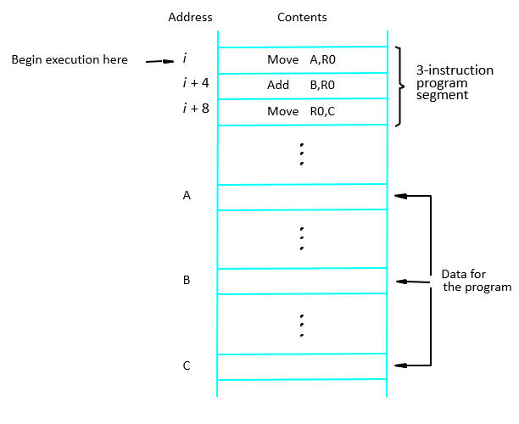
A program for c ←[A]+[B]

Slide 3
Instruction execution…
‘i’ is placed into the PC
It is a Two phase procedure :
Instruction Fetch
Instruction Execution
During instruction execution, PC is incremented by 4 ,i+4, i+8,i+12,..

Slide 4
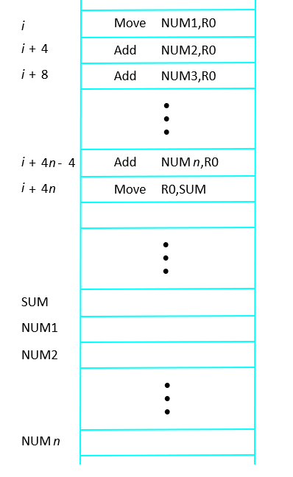
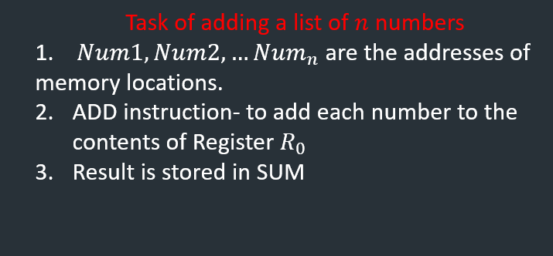

Branching
Fig: Straight line program to add $n$ numbers

Slide 5
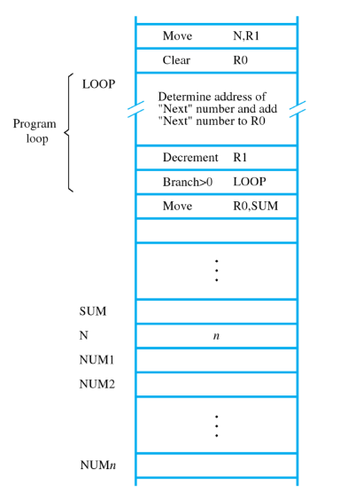

Branching…
Placing single ‘ADD’ instruction in a loop
Loop Executed many times
Register R1 used as counter
BRANCH instruction: it loads a new value into
program counter. Fetching and executing
done with new address.
Fig: Using Loop to add $n$ numbers

Slide 6
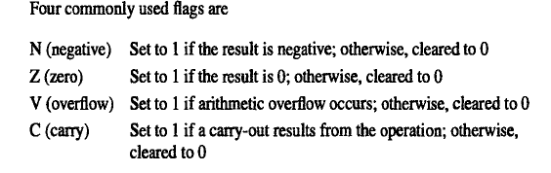
Condition Code
N (negative)
Z (zero)
V (overflow)
C (carry)

Slide 7
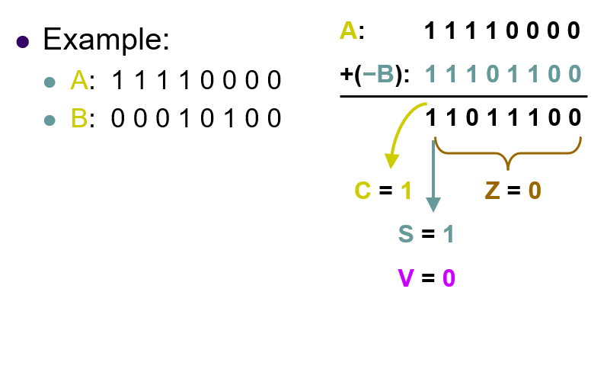

Slide 8
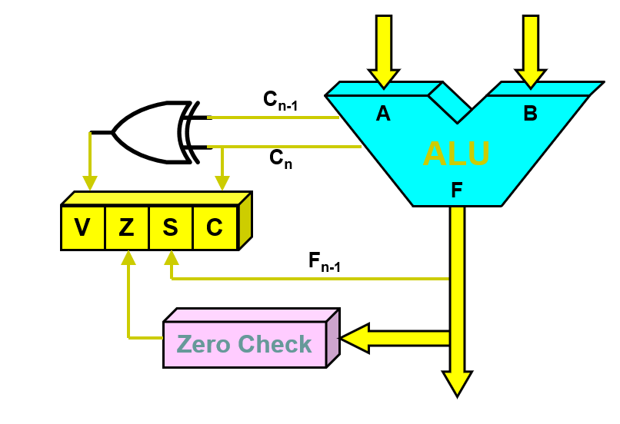
Status

Slide 9
SUBROUTINES and CALL

Slide 10
Subroutines
Particular subtasks performed (many times) using different data values.
Program branches to a subroutine: calling a subroutine (CALL instruction)
By executing ‘RET’ (return instruction); it returns to the main program.
CALL- RET mechanism is ‘SUBROUTINE LINKAGE METHOD’
Link register- saves the return address at specified location

Slide 11
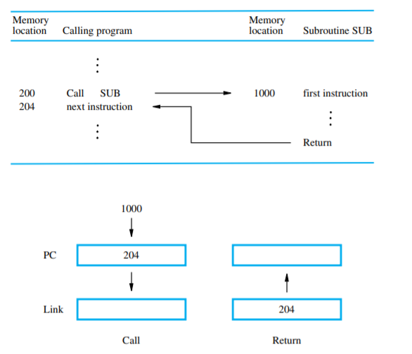

Slide 12
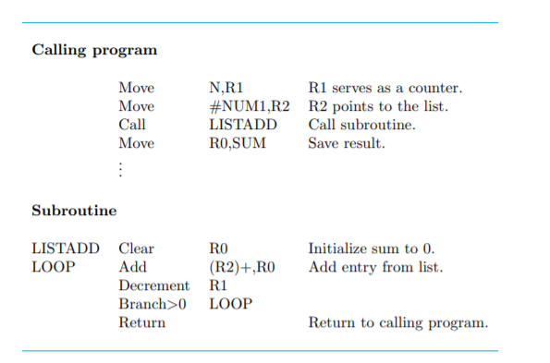

Slide 13
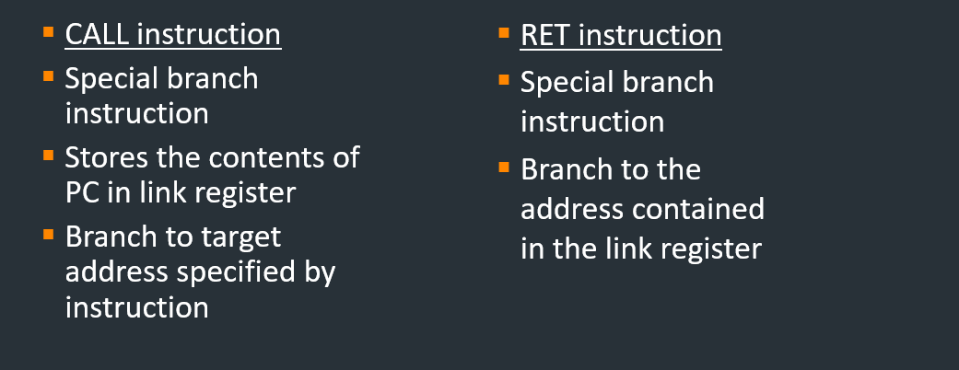
Subroutines

